Slide 1
EDA & Data story telling Project
ANALYSIS ON FACEBOOK UTILISATION
NAME:RUDRA PRASAD N
BATCH:JUNE2021

Slide 2
1. Introduction
Face book is an oldest and widest reaching social network around, Face book boasts a staggering number nearly of 2.8 billion monthly active Users
When creating an effective face book marketing strategy, brand must understand who is on the platform and how they are using it

Slide 3
2. Problem Statement
Facebook, Inc. is an American social media conglomerate corporation, founded on February, 2004 by Mark Zuckerberg.
People from all age groups are connected with each other through facebook.
However, there are certain differences in the way of using it, let's say sending friend requests, sending likes, comments etc.
Let's say they want to study and analyze these differences and identify the pattern out of it.
This is result will help the company to utilize these patterns in the next set of iteration development.
Maybe this hidden pattern could end up improving their application and the user experience.

Slide 4
3. Installing & Importing Libraries
Imported basic libraries such as PANDAS, NUMPY, Matplotlib, Seaborn, required to perform EDA
4. Data Acquisition & Description
Imported the face book utilization dataset (csv file) from github
website
The age of the Face book users are ranging from 13 years to 113 years.
The Users birth year is ranging from 1900 to 2000.
Average tenure of Face book users is 537 days with min of 0 days to 3139 days.
Average friend counts is 196 with minimum count a 0 and maximum of 4923.

Slide 5
Data Information
Data set has 9903(rows) user data and 15(columns) attributes of it
Data types are Float type-1 no, Integers-13 no and object-1 no
5. Data Pre-Profiling
The Gender column has 175 missing values.
The Tenure column has 2 missing values.
The data set has no duplicate data, inconsistent data.
The data set has 58574 Male users and 40254 Female Users.
The age of users ranging from 13 Years to 113 years with its median at around 25 years.

Slide 6
6. Data Pre-Processing
The missing values in Gender and tenure column has been replaced by its Mode.
7. Data Post-Profiling
No missing values in the data set now after all pre-processing of data set.
Data set is clean now and ready for EDA.

Slide 7
8. Exploratory Data Analysis
Created new column by classifying the age group in 5 categories for the purpose of our EDA. Age <18 years as Teenagers, Age between 18 to 25 years as Young Adults, 25 to 60 years as Adults, 60 to 80 years as Senior citizen and above 80 years as Super senior citizen.
Created new column by classifying the users based on the preference over Mobile and Web

Slide 8
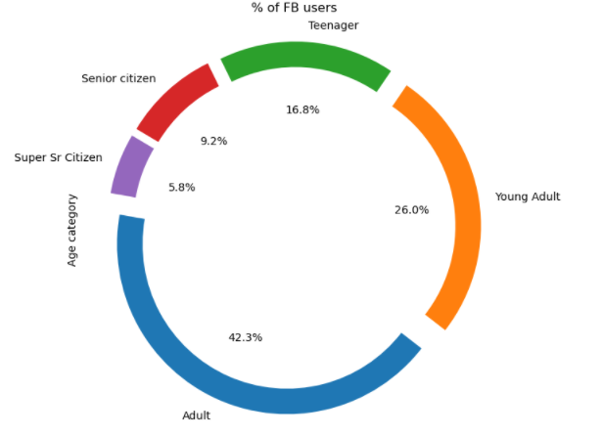
8.1 Which Age category has maximum no of Face book users?
Observations:
Maximum Facebook users are in Adult category with 42.3%, followed by Young adult with 26%.

Slide 9
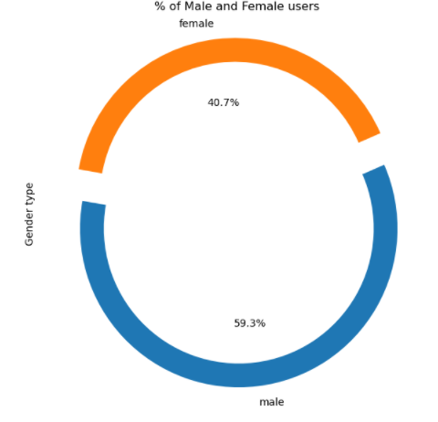
8.2 Which Gender category has highest face book users?
Observations:
Maximum Face book users are in Male category with 59.3%.

Slide 10
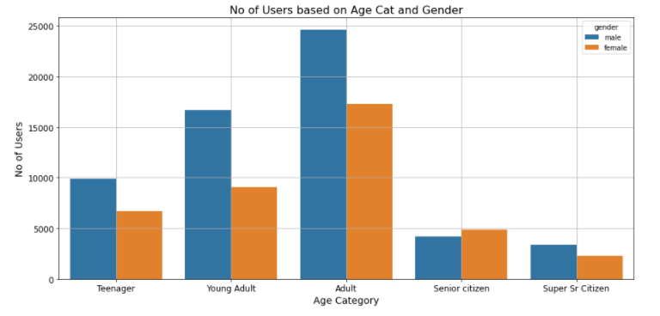
8.3 Among different Age categories which Gender category has highest facebook users?
Observations:
In all age category Male users are more than Female users except in Senior citizen group.

Slide 11
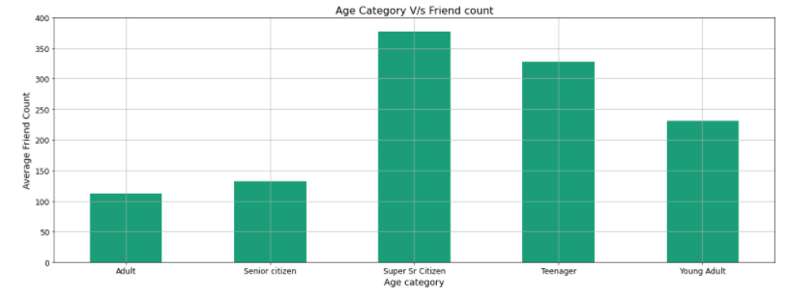
8.4 Which Age category users has highest Friend counts?
Observations:
Super Sr ctizen category has Highest Friends, followed by Teenager and then Young adult.

Slide 12
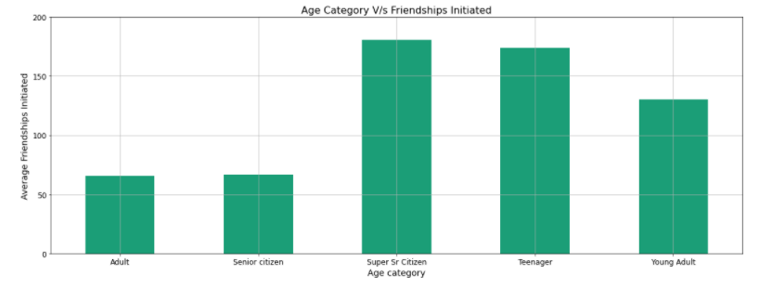
8.5 Which Age category users has Intiated highest Friend requests?
Observations:
Super Senior citizen has Initiated More Friend request, followed by Teenager and then Young Adult

Slide 13
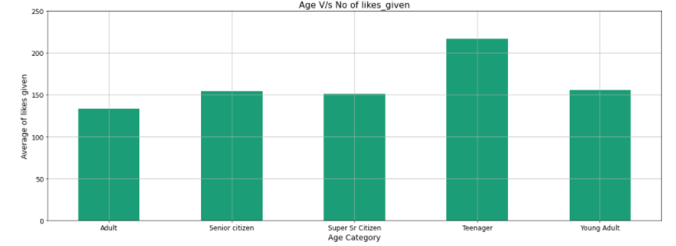
8.6 Which Age category users gives more Likes?
Observations:
Teenager category users gives more likes followed by Young Adult and Senior citizen.

Slide 14
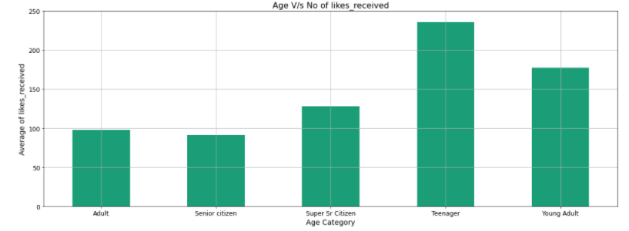
8.7 Which Age category users Recives more Likes?
Observations:
Teenager category users receives more likes followed by Young Adult.

Slide 15
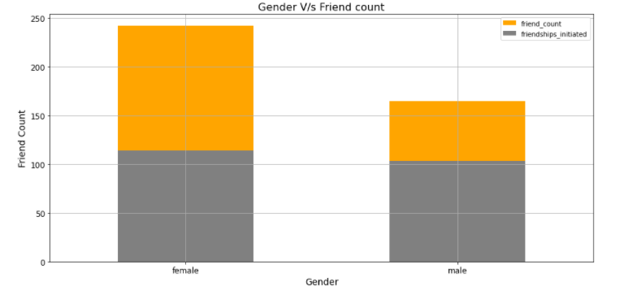
8.8 Which Gender category users has more Friend count and initiated more friend requests?
Observations:
Female users has more Friends and initiates more Friend requests.
Also both male and female users has more friend counts then friends initiated.

Slide 16
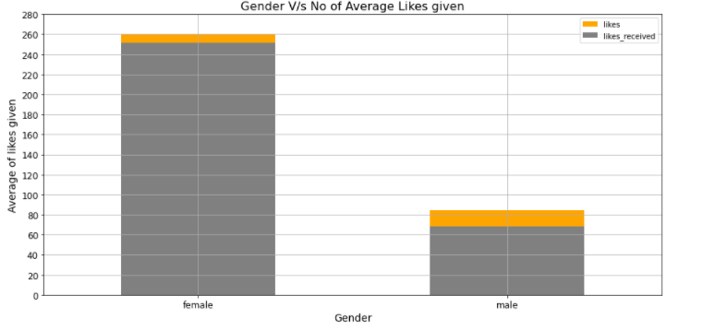
8.9 Which Gender category users gives more Likes and receives more Likes?
Observations:
Female users gives and receives more likes.
Also both Female and Male gives more likes than they received

Slide 17
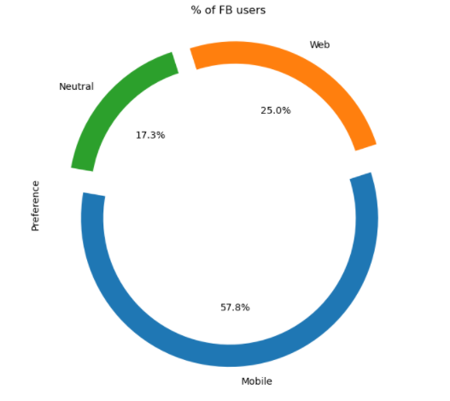
8.10 Which is the most preferred option for using Face book among all the users?
Observations:
Mobile App is the most preferred option to use face book.
57.8% of users prefer Mobile App.

Slide 18
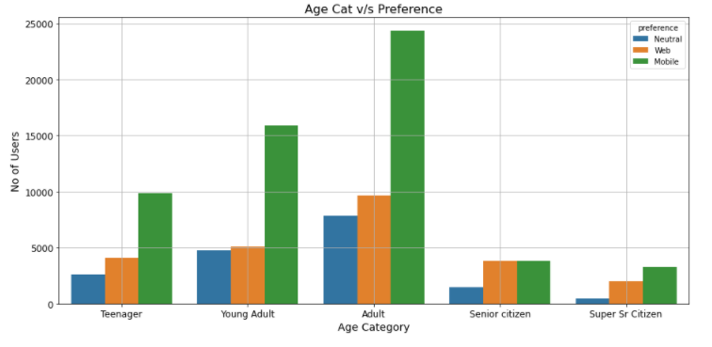
8.11 Which is the most preferred option for using Face book among different Age categories?
Observations:
All Age group users prefer Mobile app over web, except senior citizen who prefers both Web and mobile equally

Slide 19
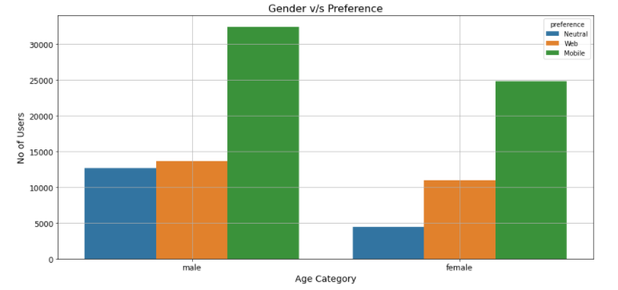
8.12 Which is the most preferred option for using Face book among different Gender categories?
Observations:
Both Male and Female users prefer Mobile app

Slide 20
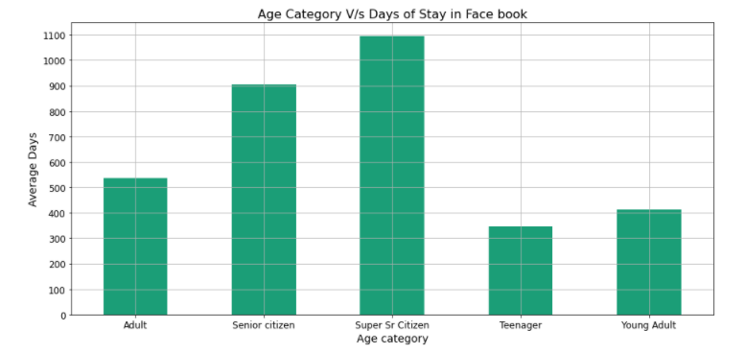
8.13 Which age group users are having highest tenure in the facebook?
Observations:
Super senior citizen stay on face book is longer than any other categories

Slide 21
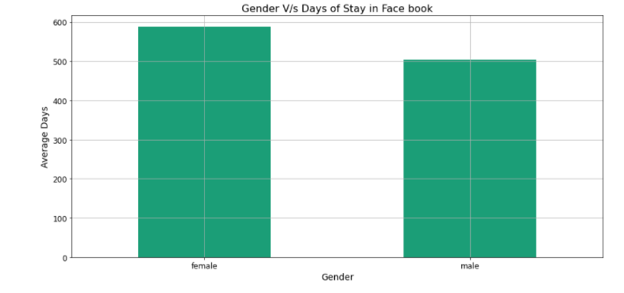
8.14 Which gender category users are having highest tenure in the face book?
Observations:
Female users tenure on face book is longer than male users.

Slide 22
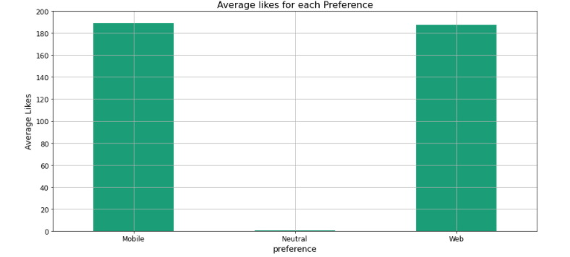
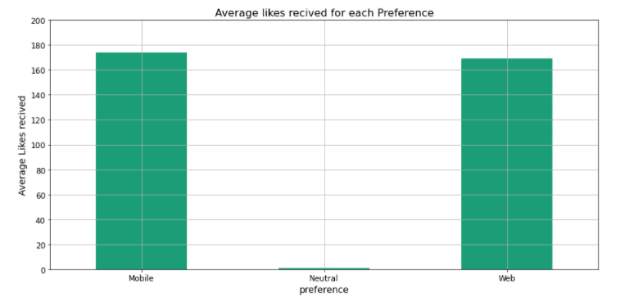
8.15 Which Users gives and receives more Likes among Mobile App and Web?
Observations:
Both mobile user and web user gives and receives almost same no of likes

Slide 23
9. Summarization
9.1 Conclusion
The Face book has maximum users from Male category and maximum of users belong to Adult age group.
Among all age categories Super senior citizens has highest number of Friends and also initiates maximum Friend requests. Hence they are more interested in making Friends and expanding there social connections through Face book.
Teenager Users are usually like to give more likes to others and receive likes from others. Hence they are using Face book to know there friends status or photos and appreciate them.
Among Male and Females, Female users are having more Friends and also has highest number of Friend request. Also Female users gives and receives more likes. Hence when compared to Male, Female users are more active in the Face book and socialize with their friends.
Among all the age group and all gender category, Mobile App is most preferred way of using the Face book.
Among all the age category, Super senior citizen users are having the longest stay on the Face book. Also Female users prefer to stay longer on the Face book

Slide 24
9.2 Actionable Insights
As Mobile App is the preferred option among all the users, Face book shall concentrate developing the updates and more user friendly features on the mobile app.
As female users are more active in the face book, the company can look to use this to market the female oriented products or information's which will increase the company revenue and also retention of Female users
As we can see the male users are not so active on the face book, even though they are highest users, company can look to attract male users also by giving more friend suggestions and product suggestions, which makes them more active users and also longer tenure

Slide 25
THANK YOU

